Slide 1
Innovative solution provider
- Company profile -

Slide 2
Contents
Corporate Overview
Organization Chart
Core Value
Working Process
Experience
Pictures
Corporate Vision

Slide 3
Corporate Overview
Company name
CEO
Establishment date
Location
Capitalization
Employees
: INNOVO SOLUTION. CO., LTD.
: Young-Jae Chung
: 13 Feb. 2007
: Head office & Factory
333-9, Sangdeawon1-dong,
Jung-won-Gu Seongnam-Si, Gyeonggido,
462- 807 ,Korea
: ₩ 1,900,000,000
: 8 P’s

Slide 4
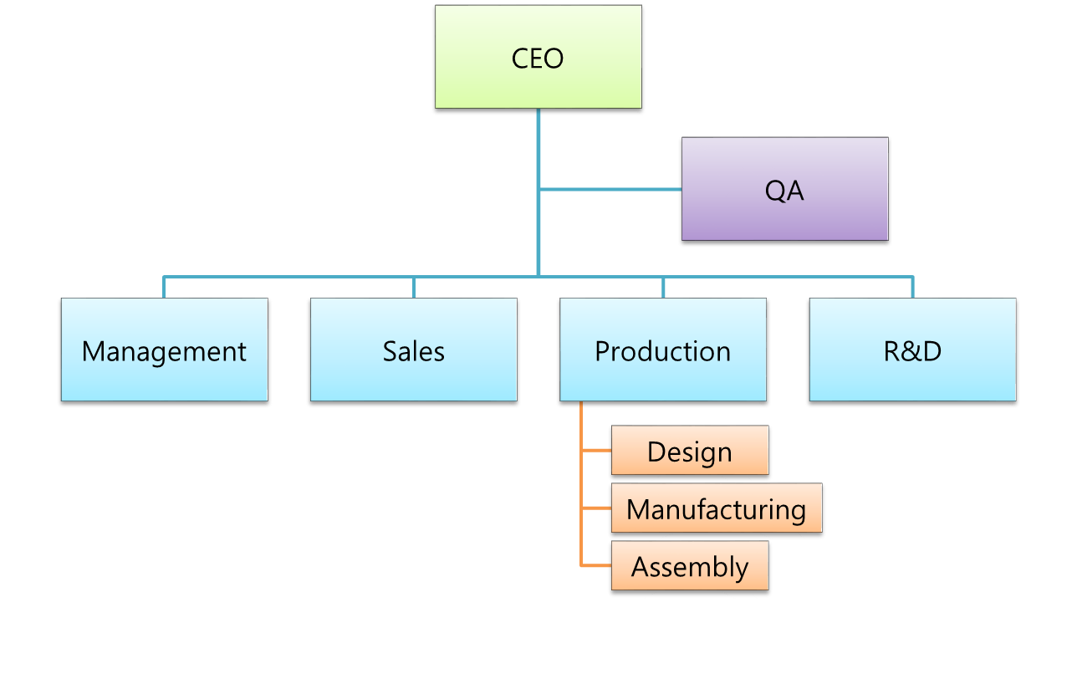
Organization Chart

Slide 5
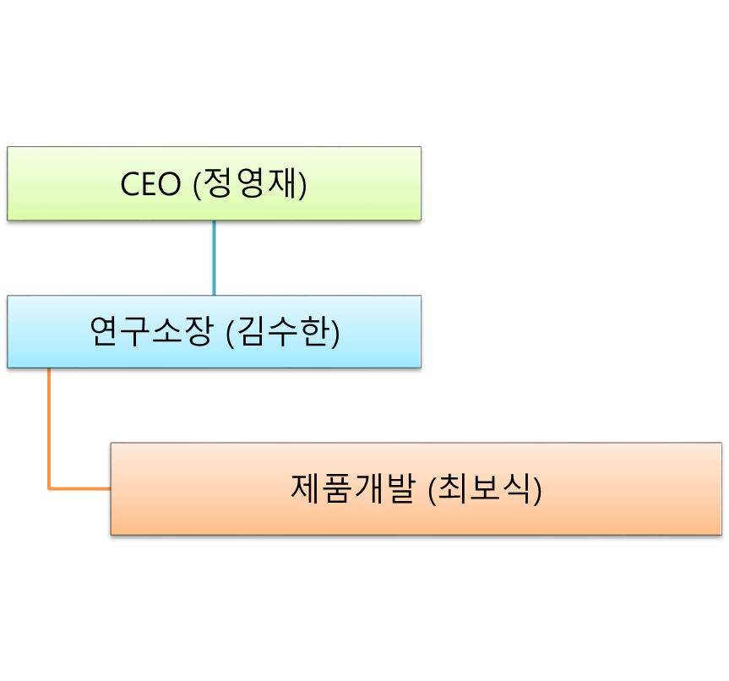
Organization Chart – R&D center

Slide 6
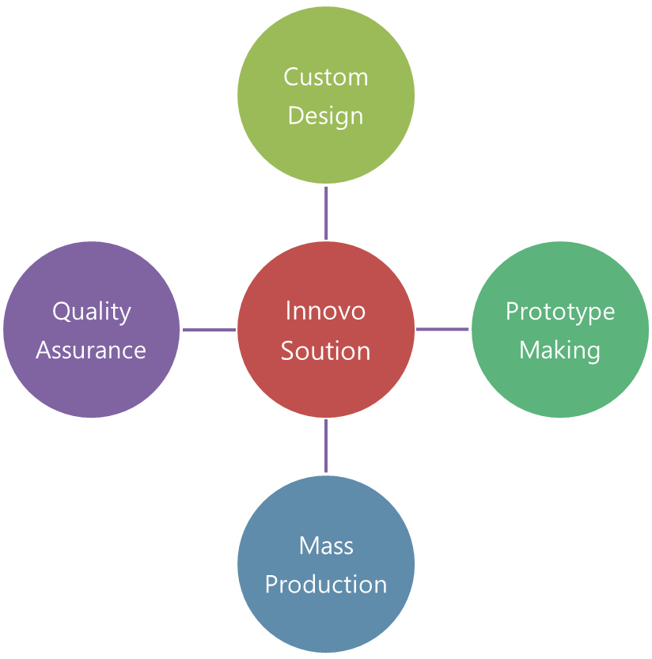
※ Core Value – Total innovative solution provider
InnovoSolution Co., Ltd service is based on close tolerance machined product with compact design in test field.
This experience will give you to make your own customized product perfectly.
We can support the prototype making and handle the mass production with our cooperative companies.
And, we can design and handle the customized quality assurance process for your own product.

Slide 7
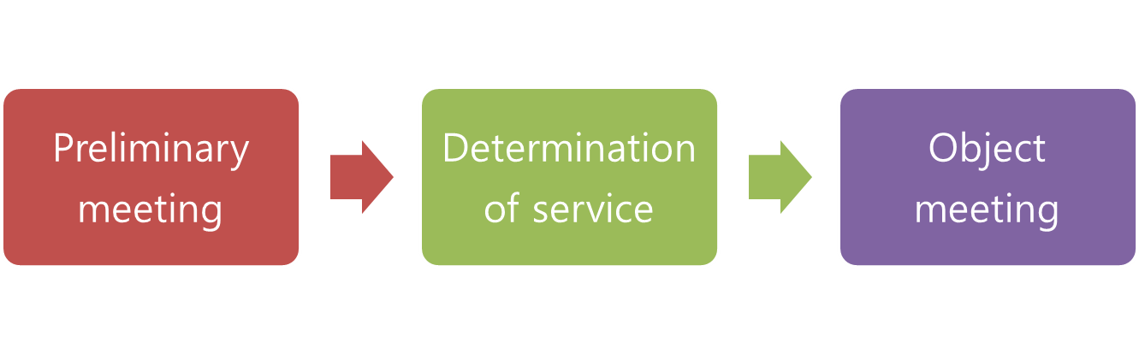
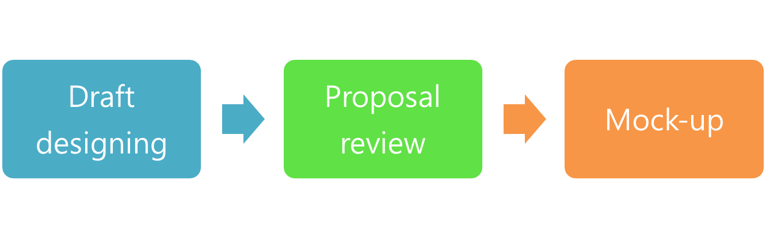
※ Working Process
→ Share the each others company introduction to start co-working
→ Define the service range based on customer’s plan
→ Share the imaginary of final product for set up a goal
→ Design you own product with 3D design simulation tool
→ Review the designed model for start the prototyping
→ Make the mock-up and prototype product
- This working process is shown the total service flow. If you want to get the partial service, please mail us anytime.

Slide 8
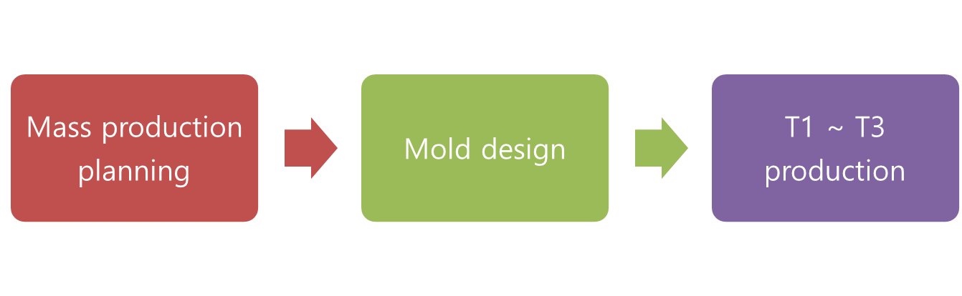
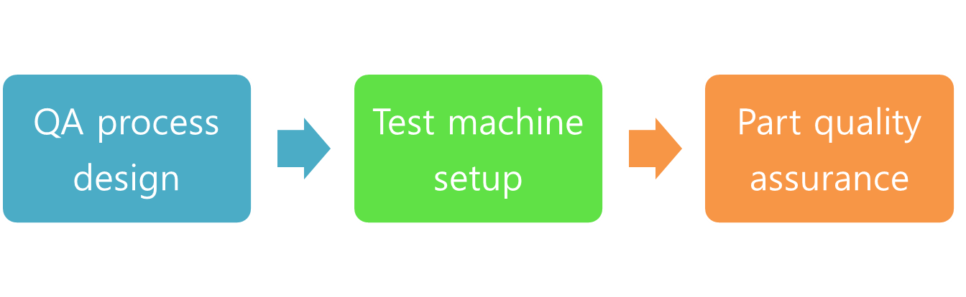
※ Working Process
→ Make a plan for mass production based on prototype product. Monthly purchasing plan needed.
→ Prepare the mold for mass production. Prototyped design can be changed little.
→ Mass production test model version #1 called T1. Finding and match the product quality for final product.
→ Part test and final test process design with our customer. This will give you a chance to having your own QA system.
→ We can make customized test machine for your own product.
→ Each part have their own characteristic. Part shape, size and other factor will checked in this process.
- This working process is shown the total service flow. If you want to get the partial service, please mail us anytime.

Slide 9

※ Working Process
→ We can build the assembly line for your own product. We have many experience to handle the very small product lesser than 1.00mm size.
→ Every product needed assembly test before sales. We also can support final test service when you needed.
→ We can handle the packing design and packing service. This service will increase your convenience before sales your product.
- This working process is shown the total service flow. If you want to get the partial service, please mail us anytime.

Slide 10
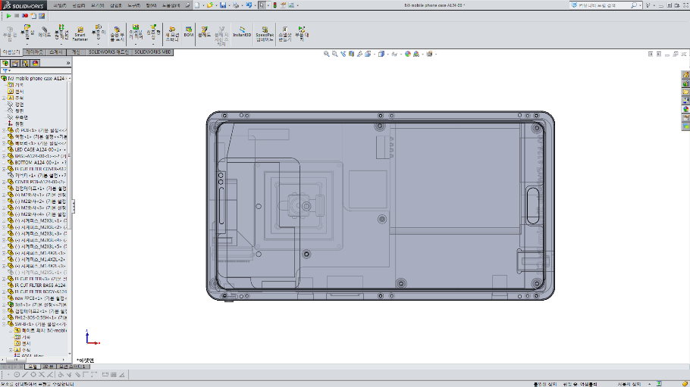
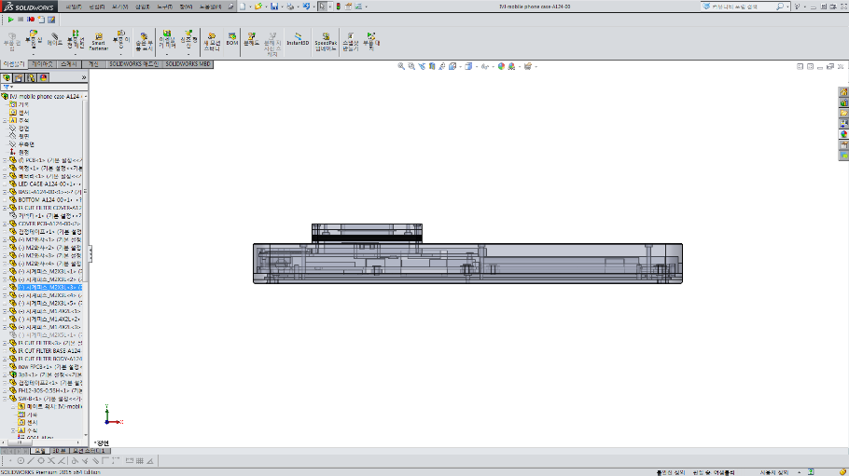
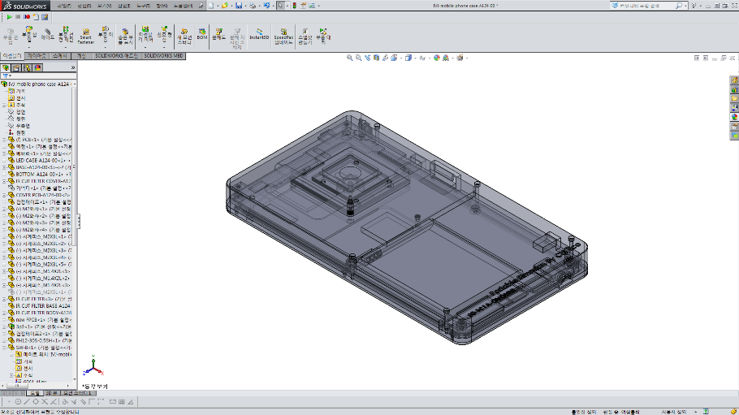
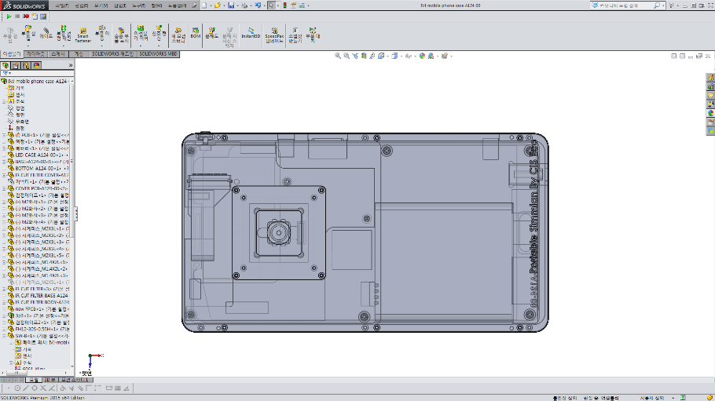
※ Experience – Product design
< Tablet case prototype drawing >

Slide 11
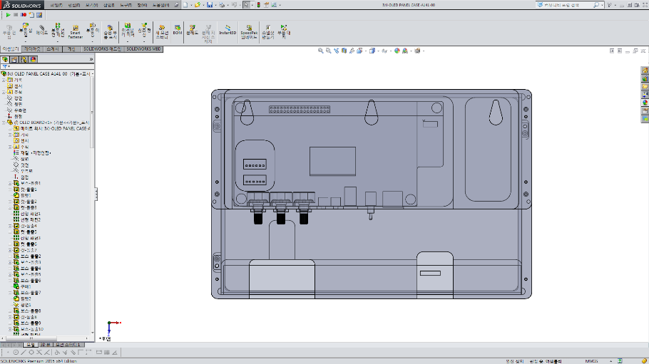
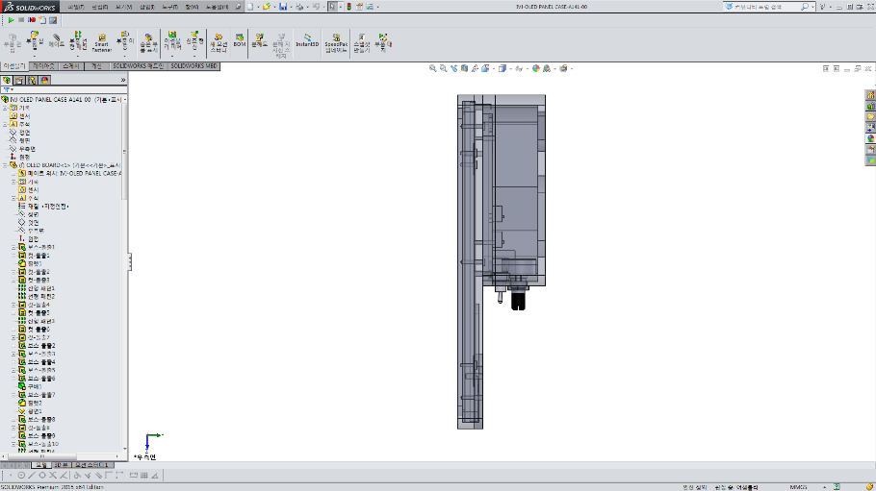
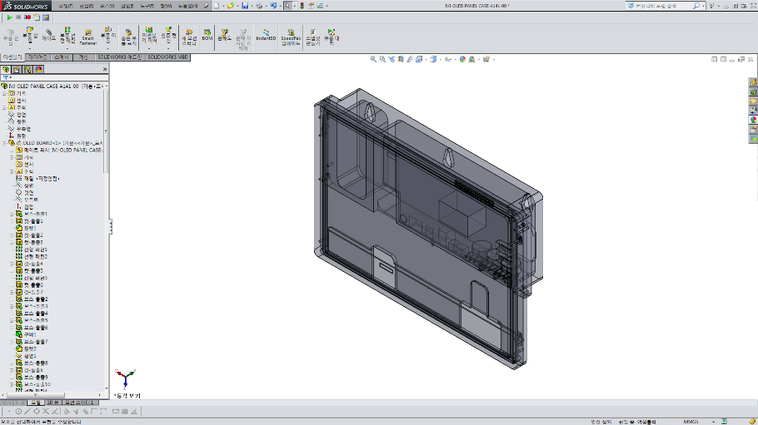
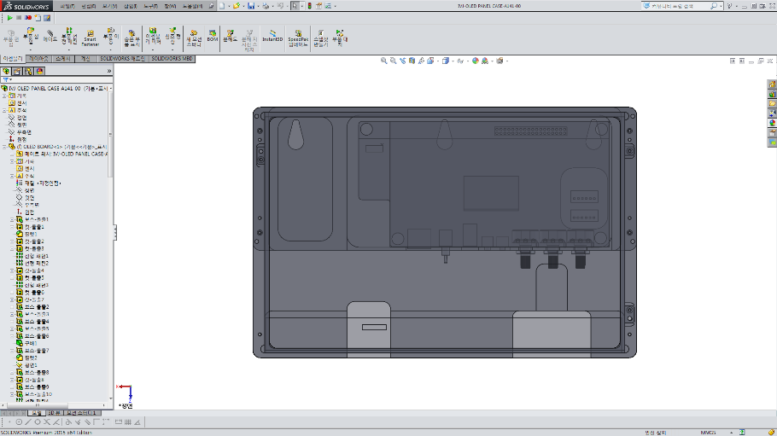
※ Experience – Product design
< Tablet case prototype drawing >

Slide 12
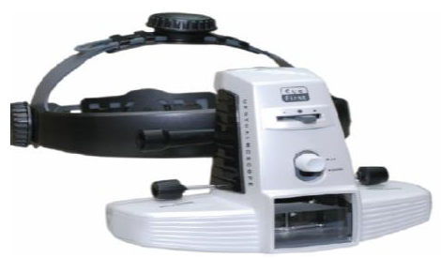
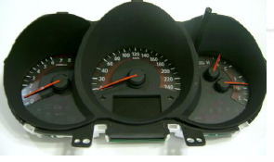
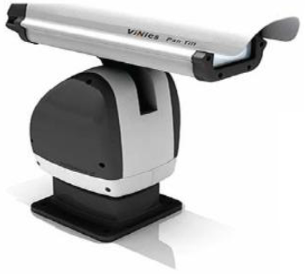
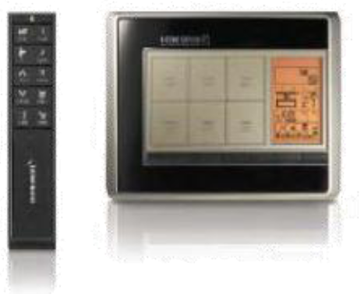
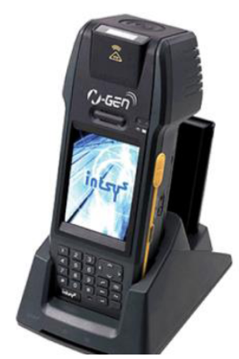
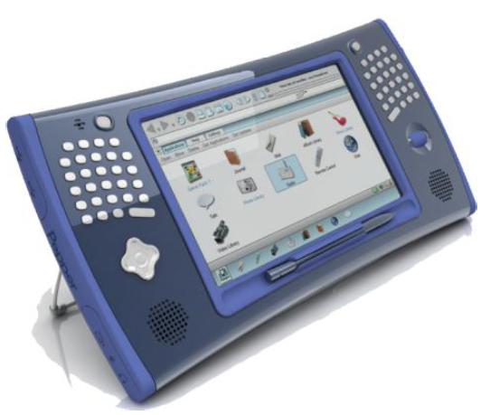
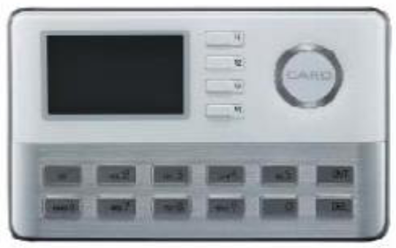
※ Experience – Final products
다양한 분야에 적용되어진 제품의 예

Slide 13
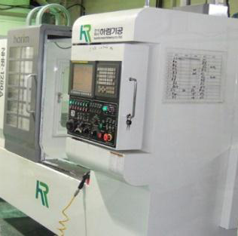
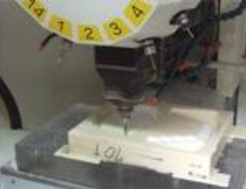
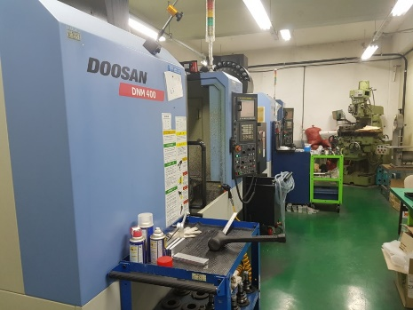
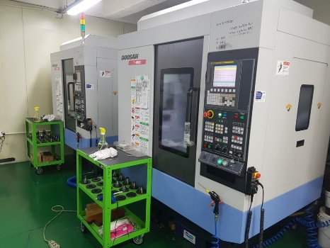
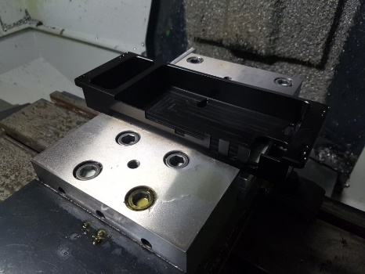
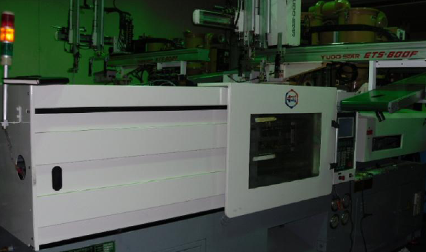
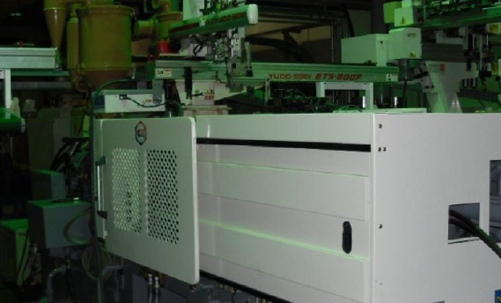
※ Pictures - Manufacturing

Slide 14
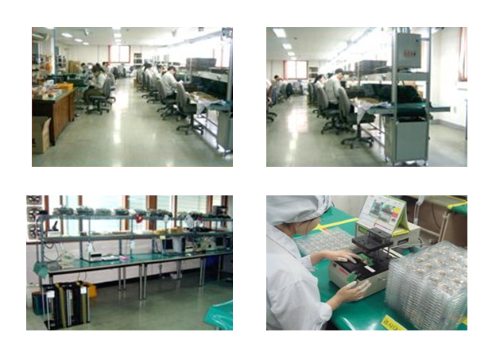
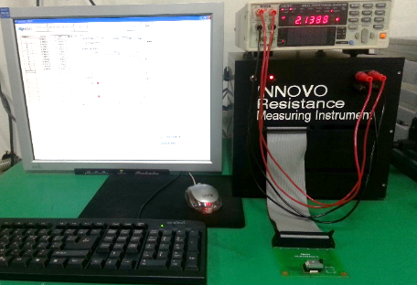
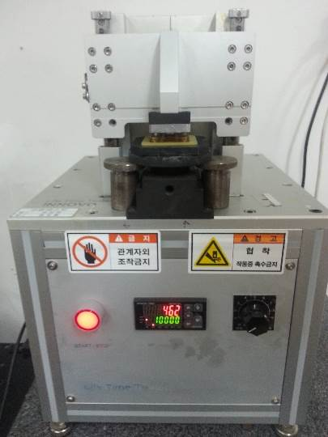
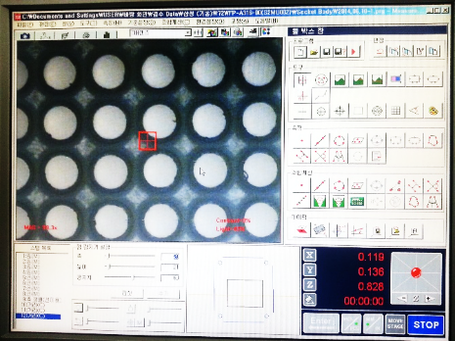
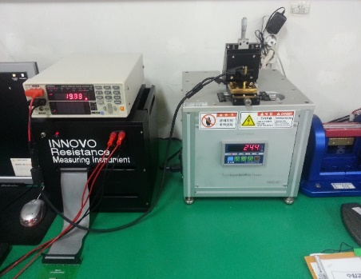
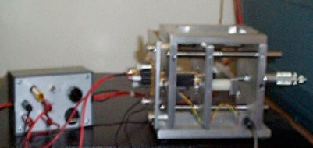
※ Pictures – Assembly and QA

Slide 15
Corporate Vision
Customer
`
Quality
Price
Performance
Delivery
Novelty
Intelligence
Creativity
Innovation
Productivity
Originality
Novelty
Creativity
Productivity
Stability

Slide 16
Thank you.

